Slide 1
Quantum Gaussian Elimination
https://youtu.be/nw0TkoGctqk
장경배

Slide 2
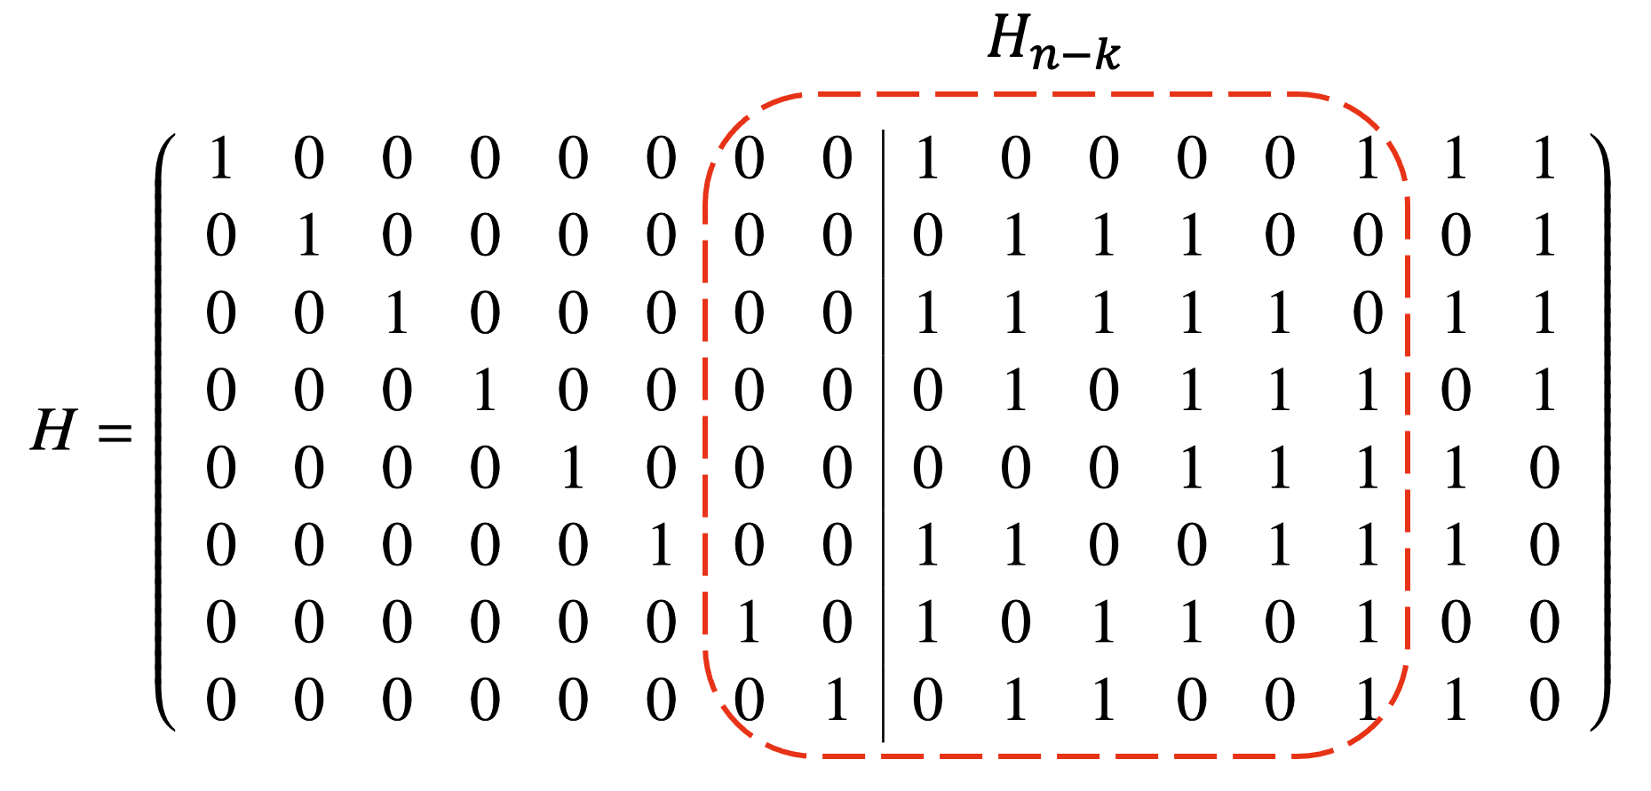





Information Set Decoding (ISD)
ISD 연산은 코드기반암호에 대한 효율적인 Brute-force
공개키의 Information set ( ), 행렬 $H_{n−k}$을 변경해가며 전수 조사
Information set의 역행렬 $×$ 암호문 $(C)$ 의 결과 벡터가 특정 (Gaussian Elimination 사용)
low-weight ($t$)를 만족할 경우, 원본 메시지 복구 $(e)$에 성공
$$−1$$
$$e$$
$$=$$
$$C$$
$$×$$
(Weight check → $t$?)
Information set
Information set (inverse)
Brute-force

Slide 3
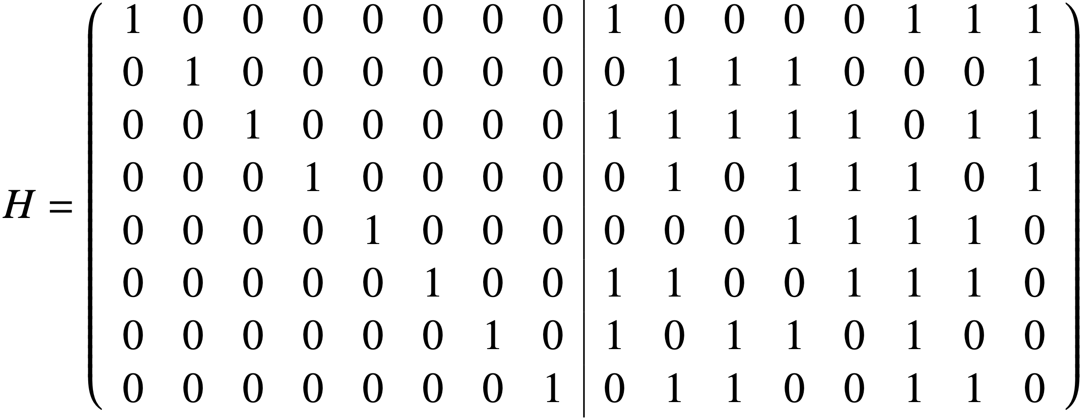

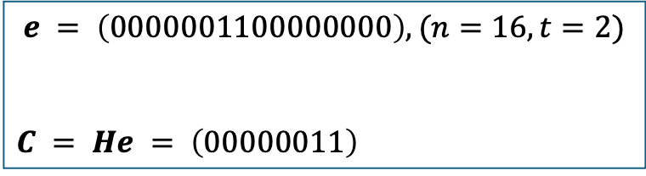




$$H_{n−k}$$
$$C$$
0
0
0
0
0
0
1
1
$$e = \left(0000001100000000\right), (n=16, t=2)$$
$$C = He = \left(00000011\right)$$
Secret
0 0 1 0 0 0 0 1
0 0 0 1 1 1 0 0
0 0 1 1 1 1 1 0
0 0 0 1 0 1 1 1
0 0 0 0 0 1 1 1
0 0 1 1 0 0 1 1
1 0 1 0 1 1 0 1
0 1 0 1 1 0 0 1
1 0 0 0 0 0 0 0
0 1 0 0 0 0 0 0
0 0 1 0 0 0 0 0
0 0 0 1 0 0 0 0
0 0 0 0 1 0 0 0
0 0 0 0 0 1 0 0
0 0 0 0 0 0 1 0
0 0 0 0 0 0 0 1
1 0 1 0 1 1 0 1
0 0 0 1 1 1 0 0
0 0 1 1 1 1 1 0
0 0 0 1 0 1 1 1
0 0 0 0 0 1 1 1
0 0 1 1 0 0 1 1
0 0 1 0 0 0 0 1
0 1 0 1 1 0 0 1
0 0 0 0 0 0 1 0
0 1 0 0 0 0 0 0
0 0 1 0 0 0 0 0
0 0 0 1 0 0 0 0
0 0 0 0 1 0 0 0
0 0 0 0 0 1 0 0
1 0 0 0 0 0 0 0
0 0 0 0 0 0 0 1
1 0 1 0 1 1 0 1
0 1 0 1 1 0 0 1
0 0 1 1 1 1 1 0
0 0 0 1 0 1 1 1
0 0 0 0 0 1 1 1
0 0 1 1 0 0 1 1
0 0 1 0 0 0 0 1
0 0 0 1 1 1 0 0
0 0 0 0 0 0 1 0
0 0 0 0 0 0 0 1
0 0 1 0 0 0 0 0
0 0 0 1 0 0 0 0
0 0 0 0 1 0 0 0
0 0 0 0 0 1 0 0
1 0 0 0 0 0 0 0
0 1 0 0 0 0 0 0
( $C$로 대체 )
( $C$로 대체 )
( $C$로 대체 )

Slide 4





1 0 1 0 1 1 0 1
0 1 0 1 1 0 0 1
0 0 1 1 1 1 1 0
0 0 0 1 0 1 1 1
0 0 0 0 0 1 1 1
0 0 1 1 0 0 1 1
0 0 1 0 0 0 0 1
0 0 0 1 1 1 0 0
0 0 0 0 0 0 1 0
0 0 0 0 0 0 0 1
0 0 1 0 0 0 0 0
0 0 0 1 0 0 0 0
0 0 0 0 1 0 0 0
0 0 0 0 0 1 0 0
1 0 0 0 0 0 0 0
0 1 0 0 0 0 0 0
1 0 1 0 1 1 0 1
0 1 0 1 1 0 0 1
0 0 1 1 1 1 1 0
0 0 0 1 0 1 1 1
0 0 0 0 0 1 1 1
0 0 0 0 1 1 0 1
0 0 0 1 1 1 1 1
0 0 0 1 1 1 0 0
0 0 0 0 0 0 1 0
0 0 0 0 0 0 0 1
0 0 1 0 0 0 0 0
0 0 0 1 0 0 0 0
0 0 0 0 1 0 0 0
0 0 1 0 0 1 0 0
1 0 1 0 0 0 0 0
0 1 0 0 0 0 0 0
1 0 1 0 1 1 0 1
0 1 0 1 1 0 0 1
0 0 1 1 1 1 1 0
0 0 0 1 0 1 1 1
0 0 0 0 0 1 1 1
0 0 0 0 1 1 0 1
0 0 0 0 1 0 0 0
0 0 0 0 1 0 1 1
0 0 0 0 0 0 1 0
0 0 0 0 0 0 0 1
0 0 1 0 0 0 0 0
0 0 0 1 0 0 0 0
0 0 0 0 1 0 0 0
0 0 1 0 0 1 0 0
1 0 1 1 0 0 0 0
0 1 0 1 0 0 0 0
( $C$로 대체 )
( $C$로 대체 )
( $C$로 대체 )
1 0 1 0 1 1 0 1
0 1 0 1 1 0 0 1
0 0 1 1 1 1 1 0
0 0 0 1 0 1 1 1
0 0 0 0 1 1 0 1
0 0 0 0 0 1 1 1
0 0 0 0 1 0 0 0
0 0 0 0 1 0 1 1
0 0 0 0 0 0 1 0
0 0 0 0 0 0 0 1
0 0 1 0 0 0 0 0
0 0 0 1 0 0 0 0
0 0 1 0 0 1 0 0
0 0 0 0 1 0 0 0
1 0 1 1 0 0 0 0
0 1 0 1 0 0 0 0
1 0 1 0 1 1 0 1
0 1 0 1 1 0 0 1
0 0 1 1 1 1 1 0
0 0 0 1 0 1 1 1
0 0 0 0 1 1 0 1
0 0 0 0 0 1 1 1
0 0 0 0 0 1 0 1
0 0 0 0 0 1 1 0
0 0 0 0 0 0 1 0
0 0 0 0 0 0 0 1
0 0 1 0 0 0 0 0
0 0 0 1 0 0 0 0
0 0 1 0 0 1 0 0
0 0 0 0 1 0 0 0
1 0 0 1 0 1 0 0
0 1 1 1 0 1 0 0
1 0 1 0 1 1 0 1
0 1 0 1 1 0 0 1
0 0 1 1 1 1 1 0
0 0 0 1 0 1 1 1
0 0 0 0 1 1 0 1
0 0 0 0 0 1 1 1
0 0 0 0 0 0 1 0
0 0 0 0 0 0 0 1
0 0 0 0 0 0 1 0
0 0 0 0 0 0 0 1
0 0 1 0 0 0 0 0
0 0 0 1 0 0 0 0
0 0 1 0 0 1 0 0
0 0 0 0 1 0 0 0
1 0 0 1 1 1 0 0
0 1 1 1 1 1 0 0
( $C$로 대체 )
( $C$로 대체 )
( $C$로 대체 )

Slide 5




1 0 1 0 1 1 0 1
0 1 0 1 1 0 0 1
0 0 1 1 1 1 1 0
0 0 0 1 0 1 1 1
0 0 0 0 1 1 0 1
0 0 0 0 0 1 1 1
0 0 0 0 0 0 1 0
0 0 0 0 0 0 0 1
0 0 0 0 0 0 1 0
0 0 0 0 0 0 0 1
0 0 1 0 0 0 0 0
0 0 0 1 0 0 0 0
0 0 1 0 0 1 0 0
0 0 0 0 1 0 0 0
1 0 0 1 1 1 0 0
0 1 1 1 1 1 0 0
1 0 1 0 1 1 0 0
0 1 0 1 1 0 0 0
0 0 1 1 1 1 1 0
0 0 0 1 0 1 1 0
0 0 0 0 1 1 0 0
0 0 0 0 0 1 1 0
0 0 0 0 0 0 1 0
0 0 0 0 0 0 0 1
0 1 1 1 1 1 1 0
0 1 1 1 1 1 0 1
0 0 1 0 0 0 0 0
0 1 1 0 1 1 0 0
0 1 0 1 1 0 0 0
0 1 1 1 0 1 0 0
1 0 0 1 1 1 0 0
0 1 1 1 1 1 0 0
1 0 1 0 1 1 0 0
0 1 0 1 1 0 0 0
0 0 1 1 1 1 0 0
0 0 0 1 0 1 0 0
0 0 0 0 1 1 0 0
0 0 0 0 0 1 0 0
0 0 0 0 0 0 1 0
0 0 0 0 0 0 0 1
0 1 1 1 1 1 1 0
0 1 1 1 1 1 0 1
1 0 1 1 1 1 0 0
1 1 1 1 0 0 0 0
0 1 0 1 1 0 0 0
1 1 1 0 1 0 0 0
1 0 0 1 1 1 0 0
0 1 1 1 1 1 0 0
( $C$로 대체 )
( $C$로 대체 )
( $C$로 대체 )
1 0 1 0 1 0 0 0
0 1 0 1 1 0 0 0
0 0 1 1 1 0 0 0
0 0 0 1 0 0 0 0
0 0 0 0 1 0 0 0
0 0 0 0 0 1 0 0
0 0 0 0 0 0 1 0
0 0 0 0 0 0 0 1
1 0 0 1 0 1 1 0
0 1 1 1 1 1 0 1
0 1 0 1 0 1 0 0
0 0 0 1 1 0 0 0
1 0 1 1 0 0 0 0
1 1 1 0 1 0 0 0
1 0 0 1 1 1 0 0
0 1 1 1 1 1 0 0
1 0 1 0 0 0 0 0
0 1 0 1 0 0 0 0
0 0 1 1 0 0 0 0
0 0 0 1 0 0 0 0
0 0 0 0 1 0 0 0
0 0 0 0 0 1 0 0
0 0 0 0 0 0 1 0
0 0 0 0 0 0 0 1
0 0 1 0 0 1 1 0
1 1 0 0 1 1 0 1
1 1 1 0 0 1 0 0
0 0 0 1 1 0 0 0
1 0 1 1 0 0 0 0
1 1 1 0 1 0 0 0
1 0 0 1 1 1 0 0
0 1 1 1 1 1 0 0
1 0 1 0 0 0 0 0
0 1 0 0 0 0 0 0
0 0 1 0 0 0 0 0
0 0 0 1 0 0 0 0
0 0 0 0 1 0 0 0
0 0 0 0 0 1 0 0
0 0 0 0 0 0 1 0
0 0 0 0 0 0 0 1
0 0 1 0 0 1 1 0
1 1 0 1 0 1 0 1
1 1 1 1 1 1 0 0
0 0 0 1 1 0 0 0
1 0 1 1 0 0 0 0
1 1 1 0 1 0 0 0
1 0 0 1 1 1 0 0
0 1 1 1 1 1 0 0
( $C$로 대체 )
( $C$로 대체 )
( $C$로 대체 )

Slide 6


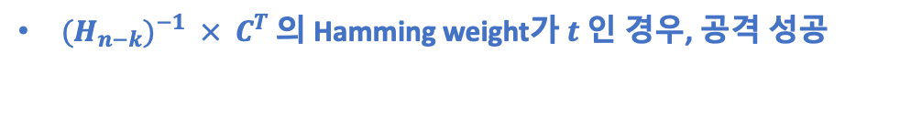





1 0 0 0 0 0 0 0
0 1 0 0 0 0 0 0
0 0 1 0 0 0 0 0
0 0 0 1 0 0 0 0
0 0 0 0 1 0 0 0
0 0 0 0 0 1 0 0
0 0 0 0 0 0 1 0
0 0 0 0 0 0 0 1
1 1 0 1 1 0 1 0
1 1 0 1 0 1 0 1
1 1 1 1 1 1 0 0
0 0 0 1 1 0 0 0
1 0 1 1 0 0 0 0
1 1 1 0 1 0 0 0
1 0 0 1 1 1 0 0
0 1 1 1 1 1 0 0
1 1 0 1 1 0 1 0
1 1 0 1 0 1 0 1
1 1 1 1 1 1 0 0
0 0 0 1 1 0 0 0
1 0 1 1 0 0 0 0
1 1 1 0 1 0 0 0
1 0 0 1 1 1 0 0
0 1 1 1 1 1 0 0
1
0 1
0 0 1
0 0 0 1
0 0 0 0 1
0 0 0 0 0 1
0 0 0 0 0 0 1
0 0 0 0 0 0 0 1
Invertible하지 않다?
만$들 수 없음$ $→$
$$({H_{n−k})}^{−1}=$$
( $C$로 대체 )
${(H_{n−k})}^{−1} × C^{T}$ 의 Hamming weight가 $t$ 인 경우, 공격 성공
1 1 0 1 1 0 1 0
1 1 0 1 0 1 0 1
1 1 1 1 1 1 0 0
0 0 0 1 1 0 0 0
1 0 1 1 0 0 0 0
1 1 1 0 1 0 0 0
1 0 0 1 1 1 0 0
0 1 1 1 1 1 0 0
0
0
0
0
0
0
1
1
1
1
0
0
0
0
0
0
$$×$$
$$=$$
$→$ Weight = 2$(t)$
$$({H_{n−k})}^{−1} { C}^{T}$$

Slide 7
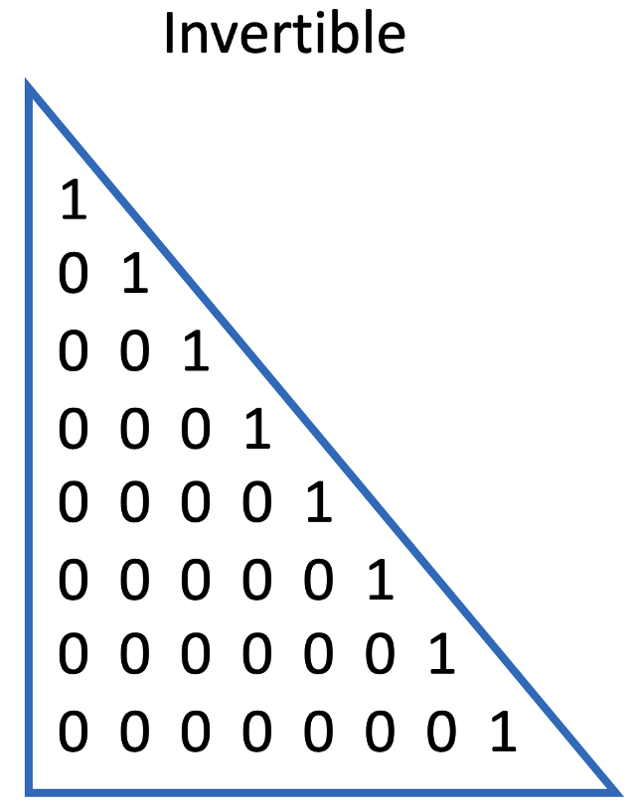
Gaussian Elimination: Parallelization
Row 대상의 병렬화에 대한 성능은 좋지 않았음, 반면, Column 대상의 병렬화에 대한 성능은 우수
Column에 대한 병렬화만 수행 → Row 대상은 추가 큐비트 대비, Depth 감소가 낮음
Good
Good
Bad
Bad
0
0
1
1
1
1
0
1
1
1
1
1
0
1
1
1
1
< Swap >
< Elimination >
7
K. Jang, H. Kim, H. Seo, “Quantum Gauss-Jordan Elimination for Code in Quantum”, Platocon’22, 2022.

Slide 8




Temp
$$C$$
Temp
$$C$$
0
0
1
0
0
0
1
0
1
1
0
1
0
0
1
1
0
0
1
0
0
0
1
0
1
1
1
1
0
0
0
1
0 0 1 0 0 0 0 1
0 0 0 1 1 1 0 0
1 0 1 1 1 1 1 0
0 0 0 1 0 1 1 1
0 0 0 0 0 1 1 1
0 0 1 1 0 0 1 1
1 0 1 0 1 1 0 1
0 1 0 1 1 0 0 1
1 0 1 0 1 1 0 1
0 0 0 1 1 1 0 0
0 0 1 0 0 0 0 1
0 0 0 1 0 1 1 1
0 0 0 0 0 1 1 1
0 0 1 1 0 0 1 1
1 0 1 1 1 1 1 0
0 1 0 1 1 0 0 1
.
.
.
→
CSWAP
Temp는 Garbage가 되고, 새로운 Temp에 현재 값 Copy
New
Temp
New
Temp
$$C$$
$$C$$
0
0
0
0
0
1
0
1
1
1
1
0
0
0
1
1
1
1
1
0
0
1
1
1 0 1 0 1 1 0 1
0 0 0 1 1 1 0 0
0 0 1 0 0 0 0 1
0 0 0 1 0 1 1 1
0 0 0 0 0 1 1 1
0 0 1 1 0 0 1 1
1 0 1 1 1 1 1 0
0 1 0 1 1 0 0 1
0
0
0
0
0
1
0
1 0 1 0 1 1 0 1
0 0 0 1 1 1 0 0
0 0 1 0 0 0 0 1
0 0 0 1 0 1 1 1
0 0 0 0 0 1 1 1
0 0 1 1 0 0 1 1
0 0 0 1 0 0 1 1
0 1 0 1 1 0 0 1
.
.
.
CNOT 사용
Toffoli 사용

Slide 9
Temp
$$C$$
Temp
$$C$$
0
0
1
0
0
0
1
0
1
1
0
1
0
0
1
1
0
0
1
0
0
0
1
0
1
1
1
1
0
0
0
1
0 0 1 0 0 0 0 1
0 0 0 1 1 1 0 0
1 0 1 1 1 1 1 0
0 0 0 1 0 1 1 1
0 0 0 0 0 1 1 1
0 0 1 1 0 0 1 1
1 0 1 0 1 1 0 1
0 1 0 1 1 0 0 1
1 0 1 0 1 1 0 1
0 0 0 1 1 1 0 0
0 0 1 0 0 0 0 1
0 0 0 1 0 1 1 1
0 0 0 0 0 1 1 1
0 0 1 1 0 0 1 1
1 0 1 1 1 1 1 0
0 1 0 1 1 0 0 1
.
.
.
→
CSWAP
Temp는 Garbage가 되고, 새로운 Temp에 현재 값 Copy
New
Temp
New
Temp
$$C$$
$$C$$
0
0
0
0
0
1
0
1
1
1
1
0
0
0
1
1
1
1
1
0
0
1
1
1 0 1 0 1 1 0 1
0 0 0 1 1 1 0 0
0 0 1 0 0 0 0 1
0 0 0 1 0 1 1 1
0 0 0 0 0 1 1 1
0 0 1 1 0 0 1 1
1 0 1 1 1 1 1 0
0 1 0 1 1 0 0 1
0
0
0
0
0
1
0
1 0 1 0 1 1 0 1
0 0 0 1 1 1 0 0
0 0 1 0 0 0 0 1
0 0 0 1 0 1 1 1
0 0 0 0 0 1 1 1
0 0 1 1 0 0 1 1
0 0 0 1 0 0 1 1
0 1 0 1 1 0 0 1
.
.
.
CNOT 사용
Toffoli 사용
재사용
Next Target

Slide 10
Gaussian Elimination: Parallelization
Row 대상의 병렬화에 대한 성능은 좋지 않았음, 반면, Column 대상의 병렬화에 대한 성능은 우수
Column에 대한 병렬화만 수행 → Row 대상은 추가 큐비트 대비, Depth 감소가 낮음
Good
Good
Bad
Bad
0
0
1
1
1
1
0
1
1
1
1
1
0
1
1
1
1
< Swap >
< Elimination >
10
K. Jang, H. Kim, H. Seo, “Quantum Gauss-Jordan Elimination for Code in Quantum”, Platocon’22, 2022.

Slide 11
Temp
$$C$$
Temp
$$C$$
0
0
1
0
0
0
1
0
1
1
0
1
0
0
1
1
0
0
1
0
0
0
1
0
1
1
1
1
0
0
0
1
0 0 1 0 0 0 0 1
0 0 0 1 1 1 0 0
1 0 1 1 1 1 1 0
0 0 0 1 0 1 1 1
0 0 0 0 0 1 1 1
0 0 1 1 0 0 1 1
1 0 1 0 1 1 0 1
0 1 0 1 1 0 0 1
1 0 1 0 1 1 0 1
0 0 0 1 1 1 0 0
0 0 1 0 0 0 0 1
0 0 0 1 0 1 1 1
0 0 0 0 0 1 1 1
0 0 1 1 0 0 1 1
1 0 1 1 1 1 1 0
0 1 0 1 1 0 0 1
.
.
.
→
CSWAP
Temp는 Garbage가 되고, 새로운 Temp에 현재 값 Copy
New
Temp
New
Temp
$$C$$
$$C$$
0
0
0
0
0
1
0
1
1
1
1
0
0
0
1
1
1
1
1
0
0
1
1
1 0 1 0 1 1 0 1
0 0 0 1 1 1 0 0
0 0 1 0 0 0 0 1
0 0 0 1 0 1 1 1
0 0 0 0 0 1 1 1
0 0 1 1 0 0 1 1
1 0 1 1 1 1 1 0
0 1 0 1 1 0 0 1
0
0
0
0
0
1
0
1 0 1 0 1 1 0 1
0 0 0 1 1 1 0 0
0 0 1 0 0 0 0 1
0 0 0 1 0 1 1 1
0 0 0 0 0 1 1 1
0 0 1 1 0 0 1 1
0 0 0 1 0 0 1 1
0 1 0 1 1 0 0 1
.
.
.
# 다음 Swap과
중첩되기 때문
CNOT 사용
Toffoli 사용
재사용
Next Target

Slide 12
Gaussian Elimination:Parallelization
Gauss-Jordan elimination 양자 회로 병렬화
기존 구현 [*]
Matrix size | Method | Qubits | X | CX (CNOT) | CCX (Toffoli) | CCCX | Multi-Controlled Swap | Depth
32 x 32 | Gauss-Jordan Elimination | 1,120 | 992 | 1,054 | 6,448 | 133,672 | 244,035 | 288,238
신규 구현: 회로 복잡도 및 Depth 대폭 감소
병렬화를 통한 2차 개선
Matrix size | Method | Source | Qubits | Clifford | T | Full depth
32 x 32 | Gauss-Jordan Elimination | 신규 | 1,584 | 205,933 | 159,712 | 10,339
 |  | 신규 + 병렬화 | 2,110 | 249,550 | 159,712 | 6,144
12
[*] K. Jang, H. Kim, H. Seo, “Quantum Gauss-Jordan Elimination for Code in Quantum”, Platocon’22, 2022.

Slide 13

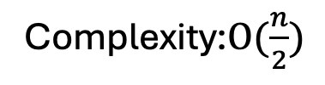

개선 방향?
Elimination 병렬화를 가져 가면서, Swap에 대한 부분 병렬화 (완전 병렬화 X)
$O(n) → O(n/2^{parallel_level})$
Complexity: $O(n)$
Complexity:$O(\frac{n}{2})$
Complexity:$O(\frac{n}{2^{2}})$
1
1
1
1
1
1
7 queries
4 queries
3 queries
13
[*] K. Jang, H. Kim, H. Seo, “Quantum Gauss-Jordan Elimination for Code in Quantum”, Platocon’22, 2022.

Slide 14

Thank you!

